Slide 1
Business Intelligence and Business Analytics (H9BIBA)

Slide 2
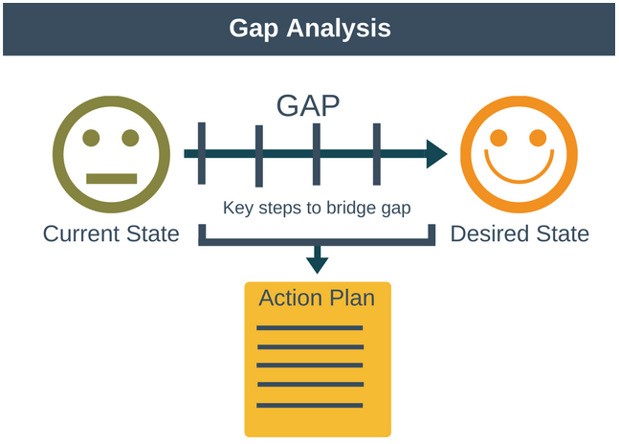
Gap Analysis
A simple tool used by organizations to raise their performance level.
Working out the necessary steps to reach final target.
Helps an organization to understand where they want to be and where they are at the moment and hence what steps they should take to close that gap.

Slide 3
Gap Analysis Overview
To get from our current state to our desired state there are a number of steps we need to take.
From these steps, we produce our action plan outlining actions to achieve each step.
Eventually the gap is closed.
It’s a general tool that works at different granularities.

Slide 4
Gap Analysis Perspective
Organization: for example, what skill sets or roles are missing or lacking?
Business direction: for example, is their a gap in our product or a gap in the market we are not serving?
Business Processes: for examp
le, can how we do things be made more efficient?
Technology: for example, are there systems we are missing, or are there incompatibilities between systems?

Slide 5
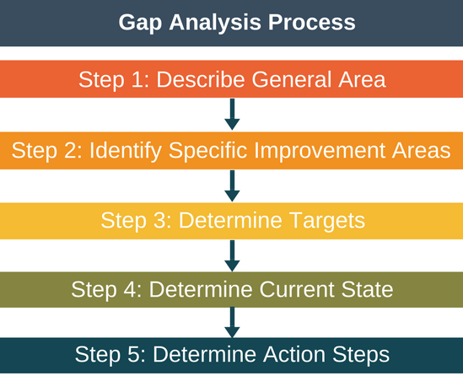
Gap Analysis Process

Slide 6
Describe General Area
In this step we describe the general area that we want to analyze and improve.
Reveals what general area is under investigation and what areas are not under investigation.
Helps to avoid scope breaks and keeps the rest of the analysis very focused.

Slide 7
Identify Specific Improvement Areas
In this step we identify specific areas for improvement within the general area described in step 1.
For example, if the general area we are investigating is our online marketing, then we may identify content creation and paid advertising as specific areas we’d like to improve.

Slide 8
Determine Targets
Now that we have identified our specific improvement areas, the next step is to set targets for each area.
A common input to this step (and the next step) is benchmarking, whereby a company will benchmark its performance in an area against its competitors performance in that same area.
Another commonly used input for this step is to analyze industry best practices.
What targets are set will depend on a combination of the time available to address the gap as well as the ambition of the organization.

Slide 9
Determine Current State
Now that we understand where we want to get to, it is important to understand where we are before putting the action plan together.
By understanding where we are it makes it more likely we’ll create a realistic action plan.
The difference between step 4 and step 3 is our “gap”, that is, the gap between where we are and where we want to be.

Slide 10
Determine Action Steps
Now that we understand the gap, we use this final step to describe the improvement steps we will take to close the gap and get to where we want to be.
In essence, this step is our action plan to get to where we want to be.
The action plan should be prioritized so as to deliver the biggest return on investment.
One way to do this is to prioritize the most critical gaps first, or to target low hanging gaps first.

Slide 11
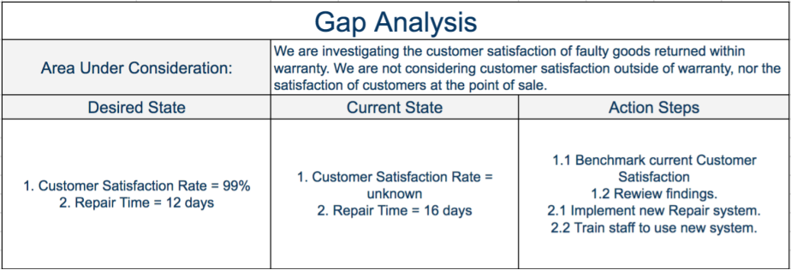
Example
Investigate the customer satisfaction of customers who return faulty equipment to an electronics company within warranty for repair.

Slide 12
Integration with Heterogeneous systems

Slide 13
Challenges of Data Migration/Integration
Diversity of data and systems.
Complexity and intricacy associated with working with CRM web service interface.
An often overlooked piece of work in CRM project.
Limited space for performance tuning.

Slide 14
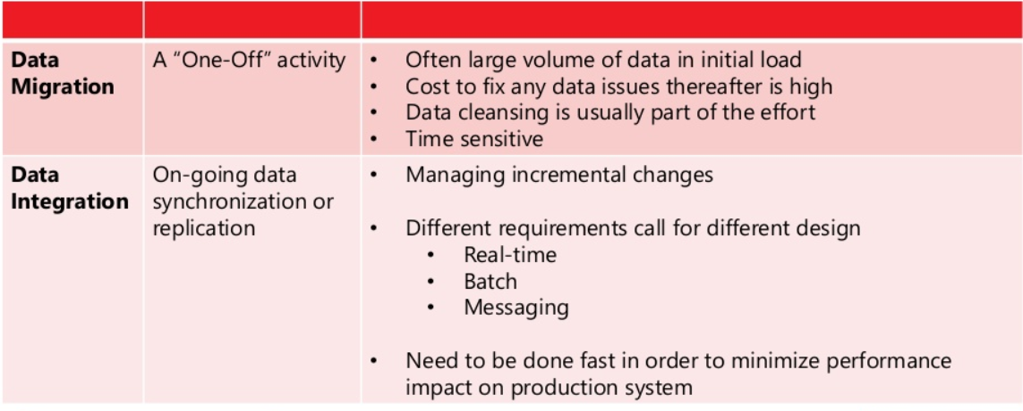
Data Integration vs. Data Migration

Slide 15
Available options
Leverage existing technologies and tools
CRM Import Data Wizard
ETL tools
SSIS
Informatica
Scribe
Connectors for Microsoft Dynamics
Etc.
BizTalk/Service Bus
Custom integration solution development
Program against CRM Web Service Interfaces (SDK Programming)

Slide 16
CRM Import Data Wizard
What is it?
Free utilities offered by the platform.
Pros
Works for simple and small data import scenarios.
Works within application, available for CRM users for self-served data imports.
Undo function is available.
Free.

Slide 17
Custom Integration Development
How does it work?
Write custom code against CRM web service interfaces using SDK or service references.
Pros
Leverage your .NET programming (C# and VB.NET) skills.
More granular control.
Flexible integration points
Plugins.
Workflows/Processes.
Standalone applications (Console, Windows Forms, and probability third-party apps)

Slide 18
Custom Integration Development continue…
Cons
Could be an exhausting effort due to large amount of coding effort
Scheduling.
Threading.
Intricacies associated with working with CRM web service interfaces.
Most likely much higher maintenance cost down the road.
Often the case, the implementation ends up with a tightly-coupled architecture style, which leads to poor maintainability.

Slide 19
Information Lifecycle Management
Information life cycle management (ILM) is a comprehensive approach to managing the flow of an information system's data and associated metadata from creation and initial storage to the time when it becomes obsolete and is deleted.
Information Lifecycle Management (“ILM”) is a sustainable storage strategy that balances the cost of storing and managing information with its business value.

Slide 20
ILM Continue …
In general, there are four stages in the information lifecycle:
Creation/acquisition of the information.
Publication of the information.
Retention of the information.
Removal of the information.

Slide 21
What Drives ILM?
Control Creation and Growth of Records.
Reduce Operating Costs.
Improve Efficiency and Productivity.
Assimilate New Technologies.
Minimize Litigation Risks.
Support better decision making.
Preserve Corporate Memory.
Foster Professionalism.

Slide 22
ILM at a Glance
A single global information management program that defines the lifecycle for both paper and electronic information. There are three primary components:
Determine what should be kept and who should be keeping it.
Establish how long information will be kept.
Set up a compliance program.

Slide 23
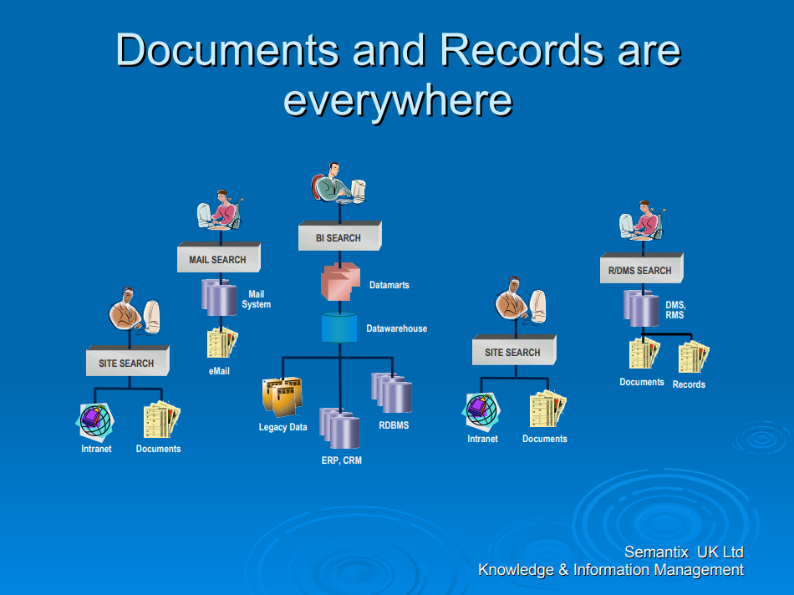

Slide 24
It’s About the Content
The format does not determine value or retention but content does. It is important to decide which record/data to keep.
File cabinets/rooms/drawers.
Off-site storage.
Email.
Shared Drives.
Intranet and Websites.
Local hard drive; handheld devices.
Storage databases.
Third party service providers.

Slide 25
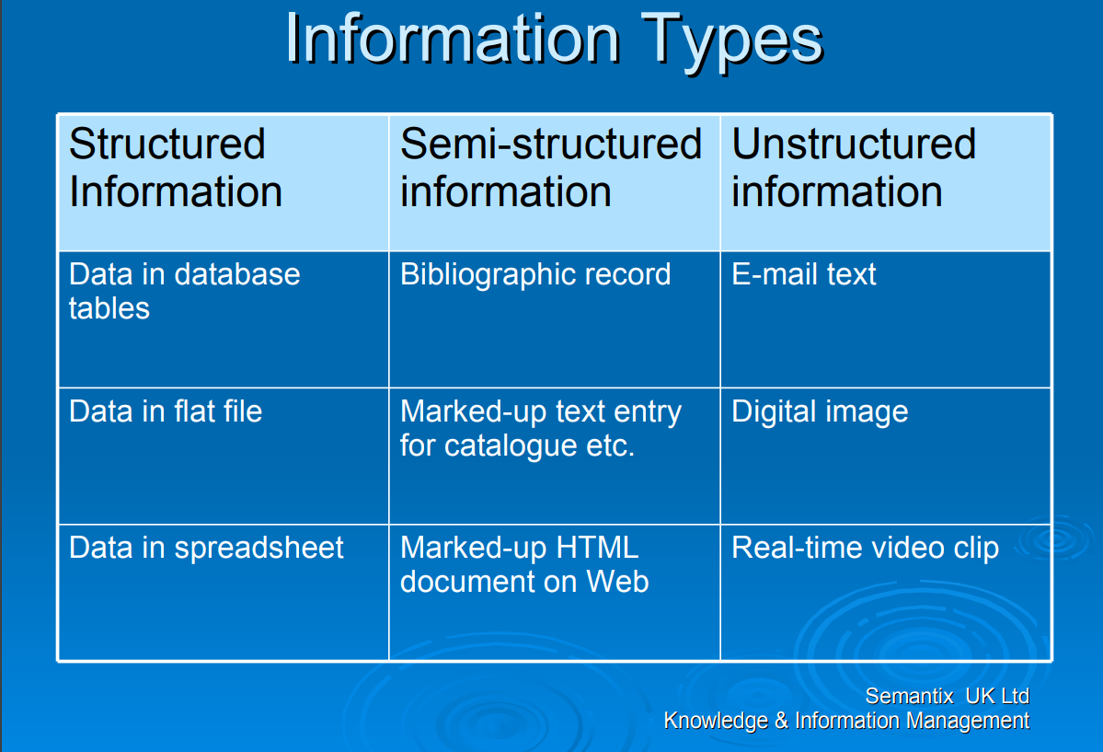

Slide 26
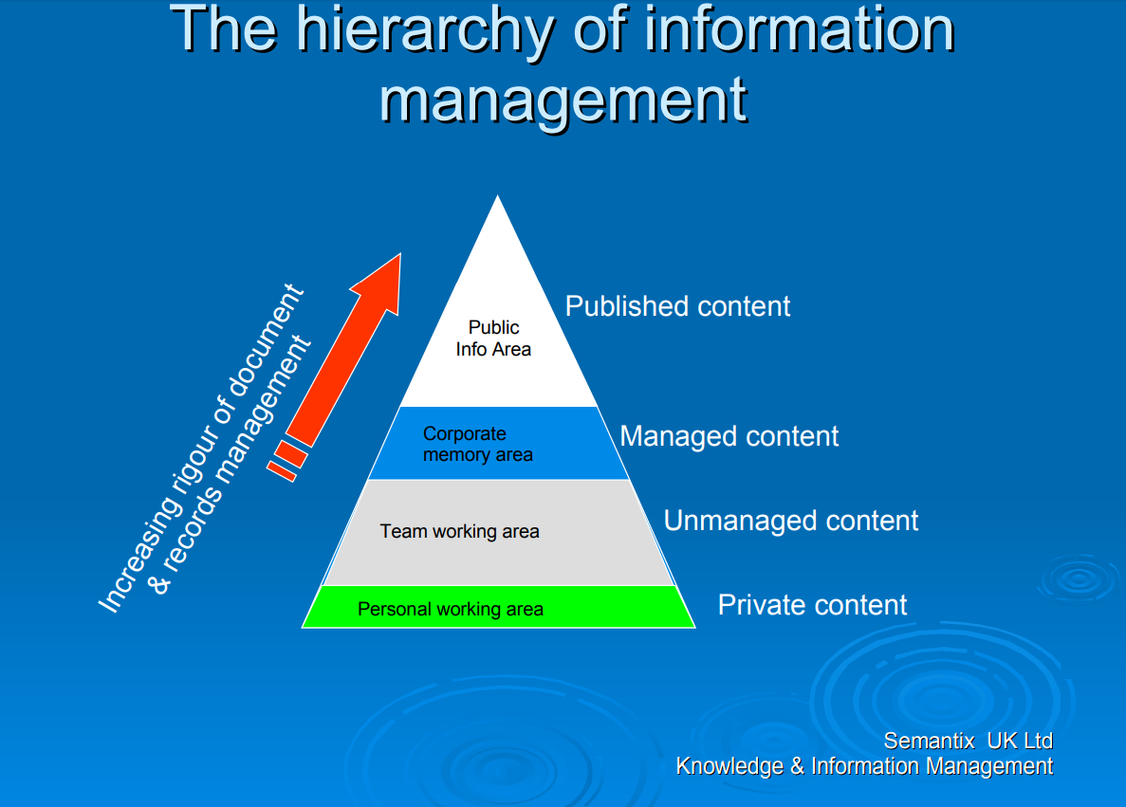

Slide 27
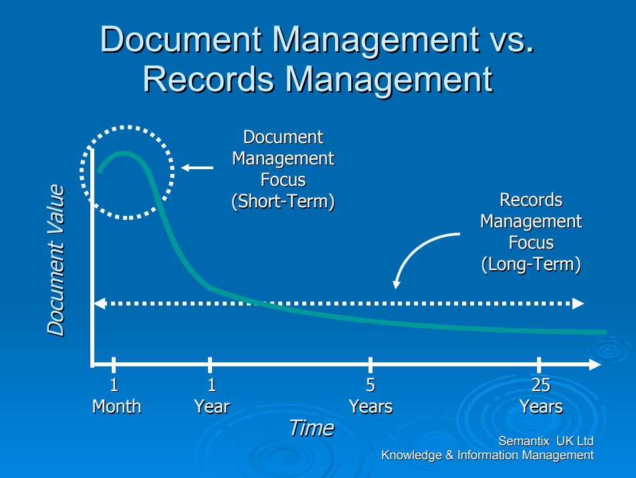

Slide 28
Monitor and Maintain
Not a one-time clean-up, but a continuous plan for managing information.
Annual employee certification of compliance.
Annual review of policy/schedule.
More frequent reviews for corporate changes, such as new locations, acquisitions or mergers.
Update legal research to locate new or revised requirements.

Slide 29
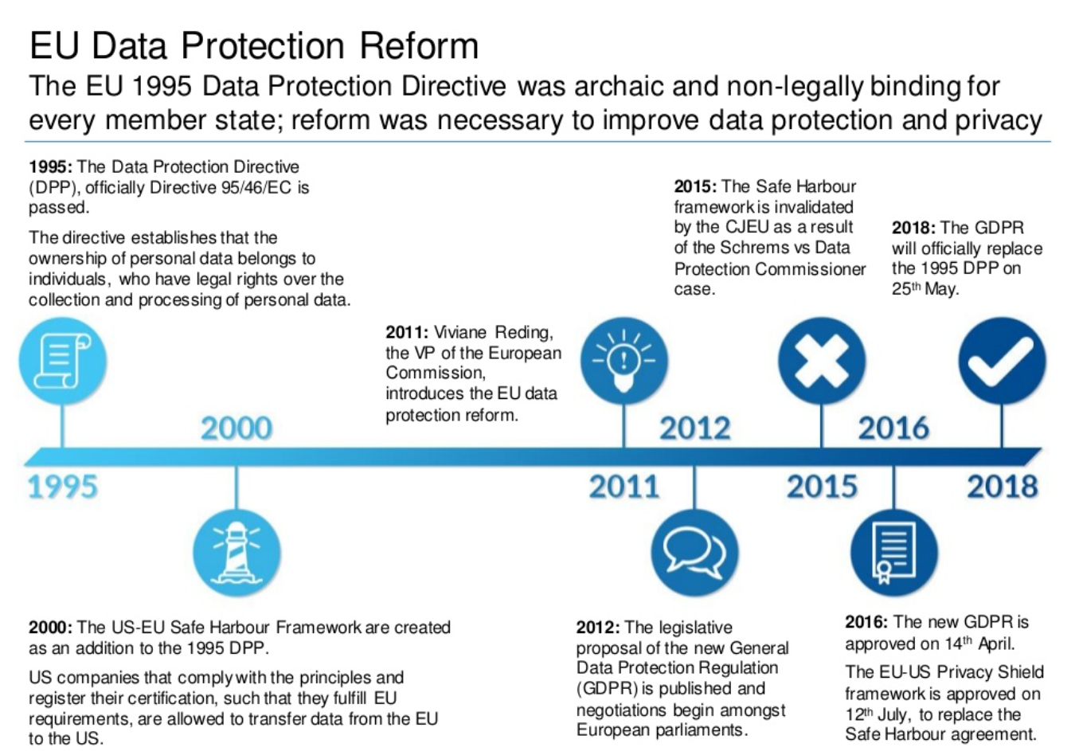
Data protection

Slide 30
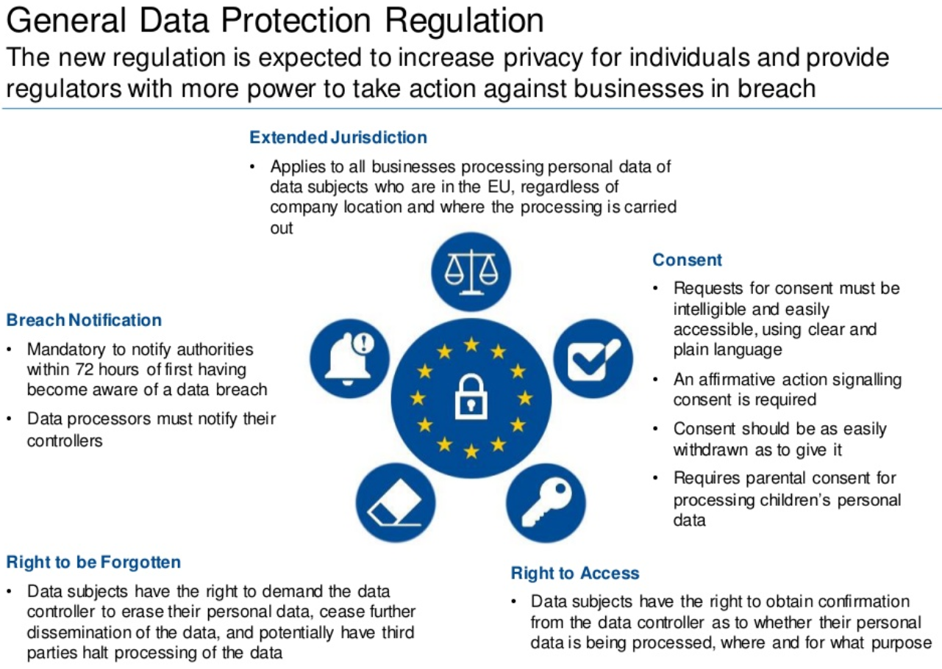

Slide 31
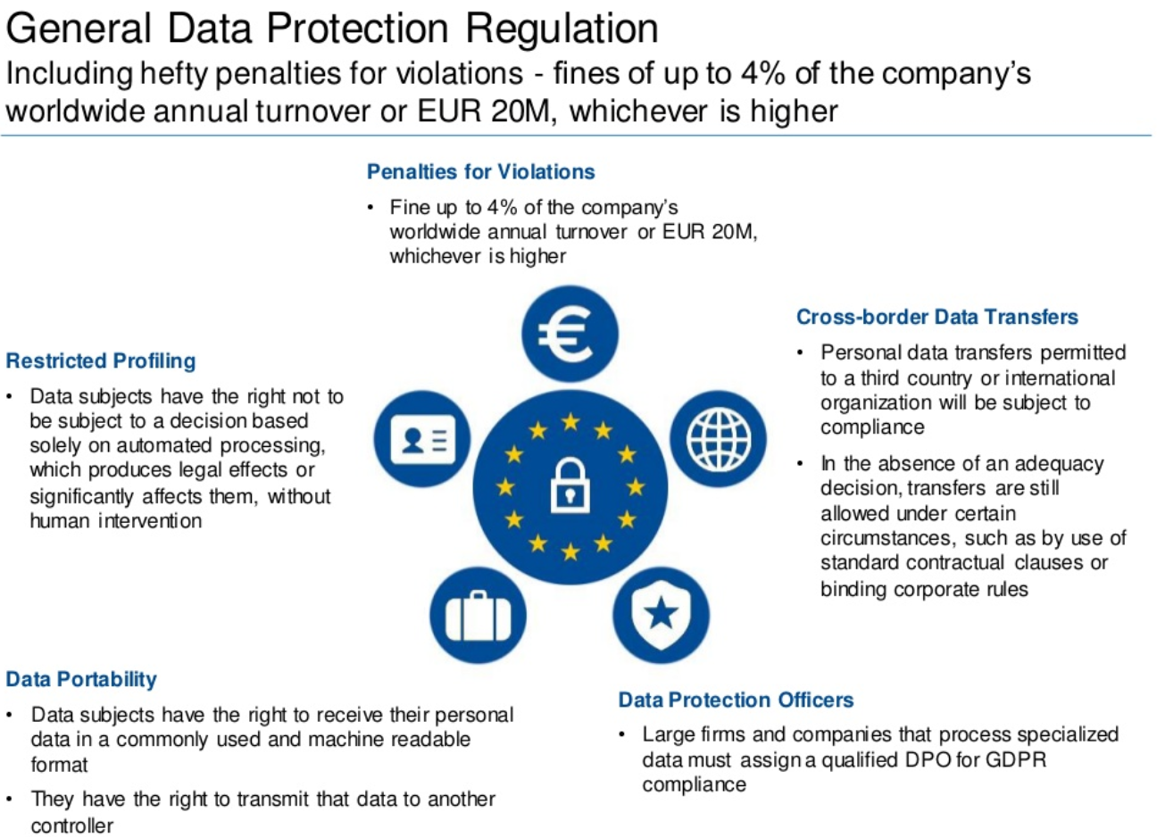

Slide 32
The problem
Huge amounts of data about you can be stored on computer, and easily searched. That data can be lost, stolen or transferred to another country easily.
People need protection from careless or inaccurate processing of data about them, they also need to be able to see what data is being held about them.

Slide 33
Personal and Sensitive information
Personal
Data that relates to a living individual who can be identified from that data
Either on its own or by combining with other information held.
Sensitive
Data about matters such as mental health, trade union membership or sexual orientation.

Slide 34
Some responsibilities of the employer
Data must be collected and processed fairly and lawfully.
Data may be collected and used only for specified and lawful purpose.
Data must be adequate, relevant and non-excessive.
Data must be kept accurate and up-to-date.
Data must not be kept longer than necessary.
Data must be processed in accordance with the rights of subjects.
Data must be kept secure against unauthorised processing, damage or loss.
Etc.

Slide 35
Security challenges
Hacking.
Cyber Theft.
Unauthorized use at work.
Software Piracy.
Piracy of intellectual property.
Computer viruses and worms.

Slide 36
Ethical responsibility of business professionals
Business ethics are concerned with
Equity.
Rights.
Honesty.
Exercise of corporate power.

